Slide 1
Nested Try Catch,except Final Block In Python
SlideMake.com

Slide 2
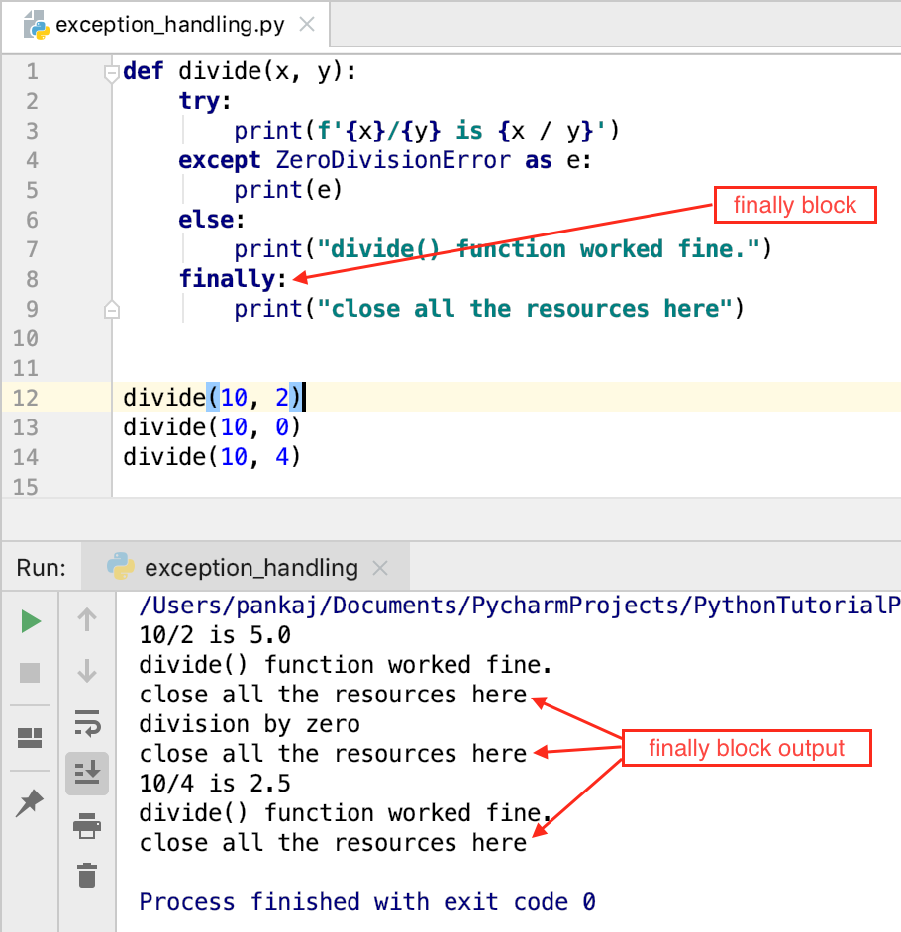
Introduction to Exception Handling in Python
Python uses try, except, else, and finally blocks to handle exceptions and ensure code runs smoothly.
Proper exception handling helps manage errors gracefully and maintain program stability.
Nested try-except blocks allow for handling specific exceptions within different code sections for finer control.
Notes:
Image source: https://www.askpython.com

Slide 3
Basic Try-Except Structure
A try block contains code that may raise exceptions, while except blocks specify how to handle these errors.
Multiple except blocks can be used to handle different types of exceptions separately.
The finally block executes code regardless of whether an exception occurred, often used for cleanup.
Notes:
Image source: https://pythononline.ru

Slide 4
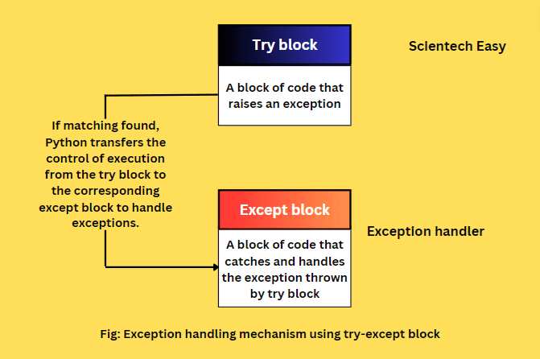
Nested Try-Except Blocks
Nested try blocks are used to handle exceptions in complex situations where multiple error types may occur at different levels.
Inner try-except blocks can catch exceptions locally, allowing outer blocks to handle issues not caught earlier.
Proper indentation is crucial for nested try-except blocks to ensure correct exception handling flow.
Notes:
Image source: https://www.scientecheasy.com

Slide 5
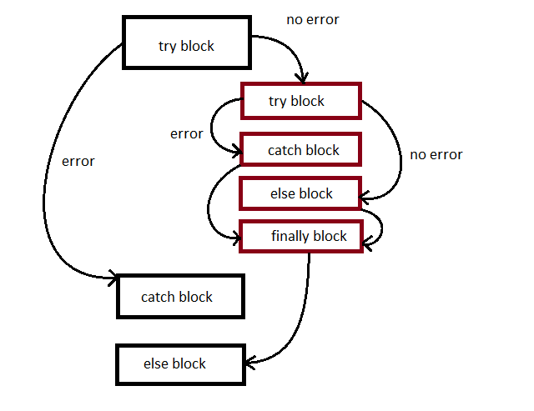
Using Finally Block in Nested Structures
The finally block executes after try and except blocks, regardless of whether an exception was raised or handled.
It is useful for releasing resources, closing files, or cleaning up after operations in nested structures.
Combining nested try-except with finally ensures robust error handling and resource management.
Notes:
Image source: https://notesformsc.org

Slide 6
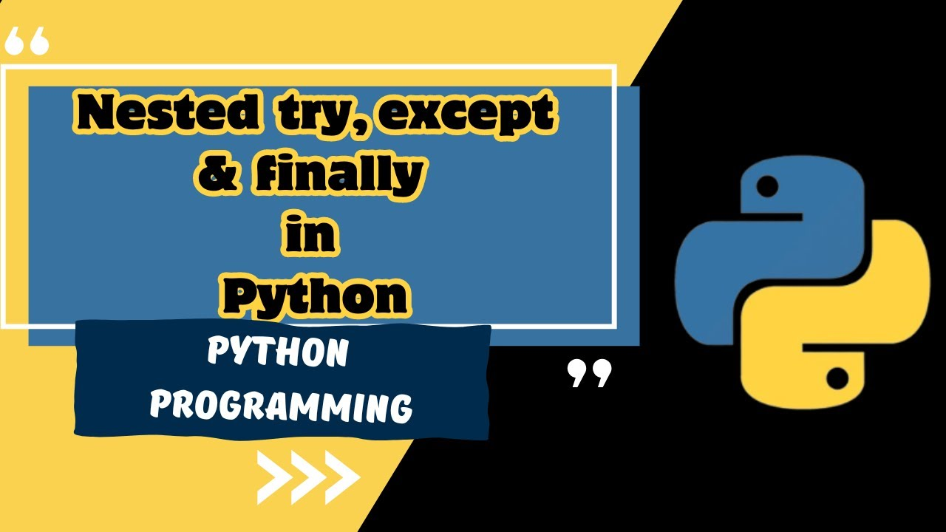
Example and Best Practices
Example: nesting try-except blocks to handle specific errors at different levels of a program.
Best practices include avoiding overly deep nesting to keep code readable and maintainable.
Always include a finally block when cleanup or resource release is necessary, regardless of exception occurrence.
Notes:
Image source: https://i.ytimg.com

Slide 7
References
Python Official Documentation on Exception Handling: https://docs.python.org/3/tutorial/errors.html
Real Python Guide on Try and Except: https://realpython.com/python-exceptions/
Effective Python: 59 Specific Ways to Write Better Python by Brett Slatkin

